Slide 1
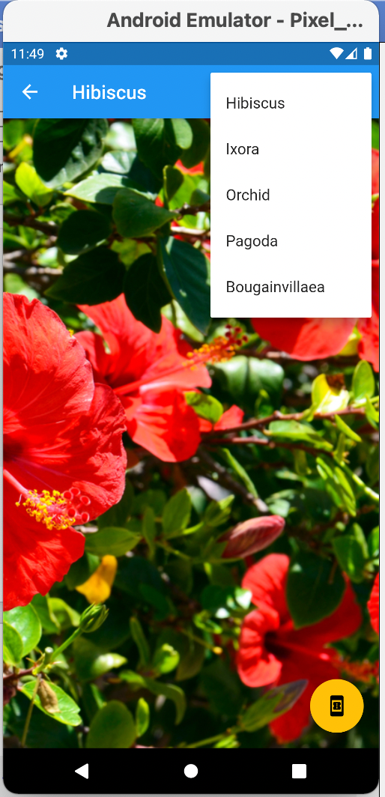
FLUTTER USER INTERFACE USING SCAFFOLDs
SAZILAH SALAM

Slide 2
Learning OUTCOMES
At the end of this lesson, learners should be able to:
Describe what is Flutter
Explain what is a Flutter widget
Design a Flutter mobile app using Scaffold widgets

Slide 3
What is Flutter?
Flutter is a user interface toolkit developed by Google that can be used for developing mobile applications.

Slide 4
What is Flutter? (2)
Developers use Dart programming language to create a Flutter mobile app.
Dart is an object-oriented, open-source, and general-purpose programming language
Dart is a general-purpose, object-oriented, open-source programming language with C-style syntax that was also developed by Google.

Slide 5
FLUTTER WIDGETS

Slide 6
What is a widget?
Everything in Flutter is a widget.
Widgets are essentially user interface elements used to design the app's user interface.

Slide 7
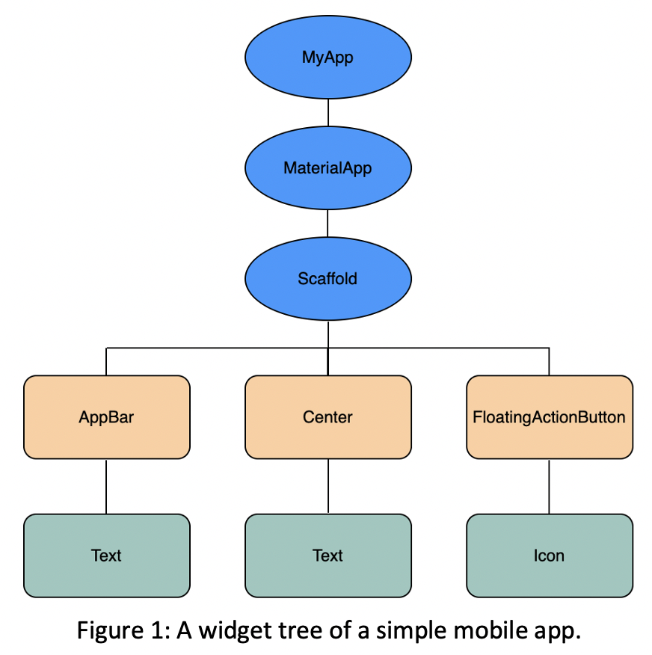
Widget tree

Slide 8
What is a widget? (2)
Figure 1 shows a widget tree of a simple mobile app.
The figure indicates that the main or the top-level widget used in building the app is the MyApp widget.
In other words, the application itself is a widget and its user interface is built using one or more widgets.
This virtue of composability enables us to build user interfaces of any complexity.

Slide 9
FLUTTER SCAFFOLD

Slide 10
FLUTTER SCAFFOLD
Scaffolds, also known as layouts, are at the heart of creating user interfaces with Flutter.
It is mostly in charge of building a foundation for the app screen on which the child widgets can stick and display themselves.

Slide 11
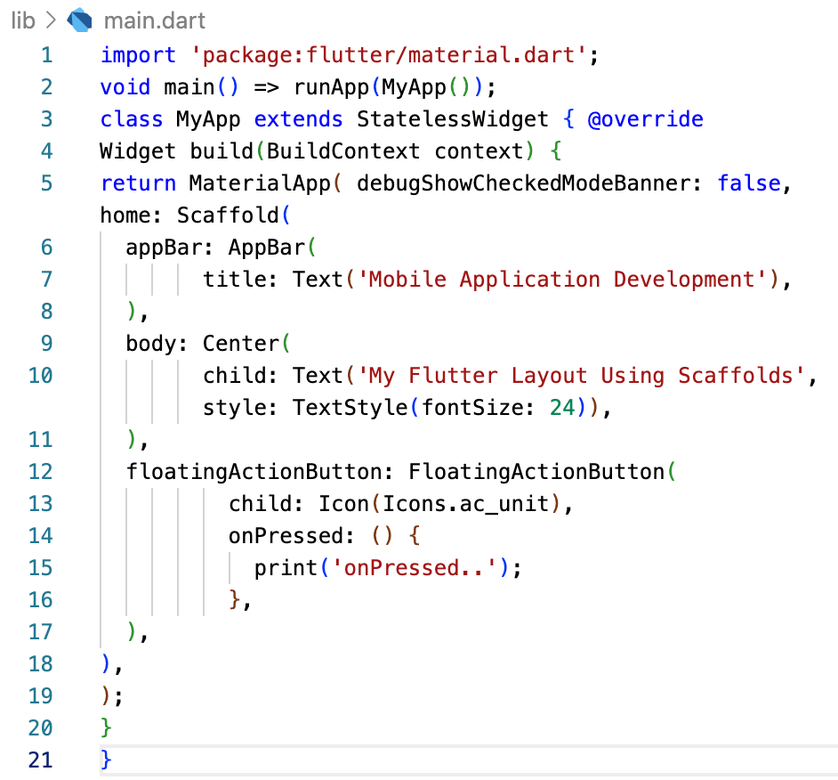
An Example of the APP code USING FLUTTER SCAFFOLD

Slide 12
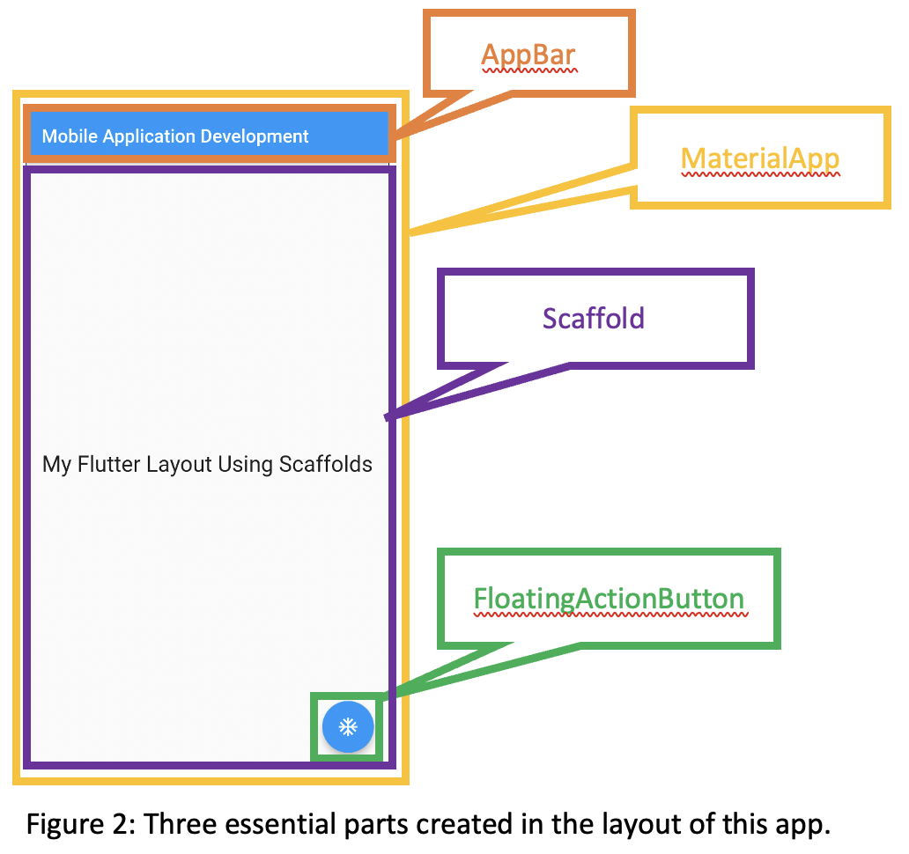
ESSENTIAL WIDGETS USED IN THE APP

Slide 13
SCAFFOLD CLASS
The Scaffold class saves us from having to manually create each visual component when setting up the appearance and design of our app.
We can write less code for the app's appearance and feel, which saves us time.

Slide 14
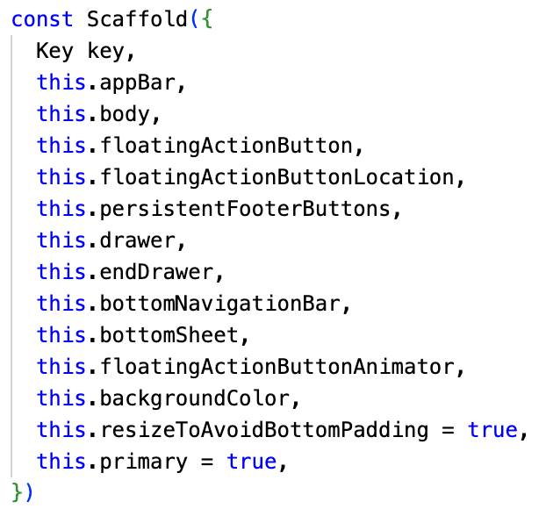
Constructor & properties of scaffold widget

Slide 15
SCAFFOLD PROPERTIES
1. appBar
appBar is primarily visible at the top of the Scaffold widget and is a horizontal bar.
It appears at the top of the screen and is the primary component of the Scaffold widget.
It makes use of the AppBar widget, which also has a number of properties.

Slide 16
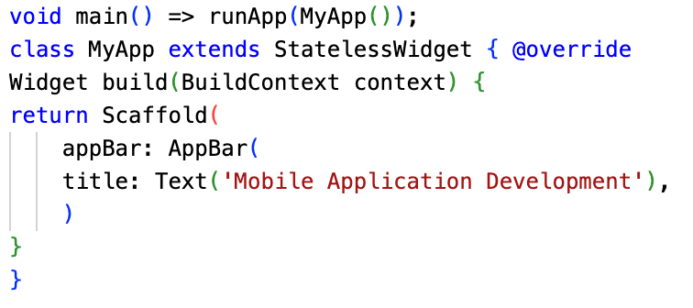
USING appBar

Slide 17
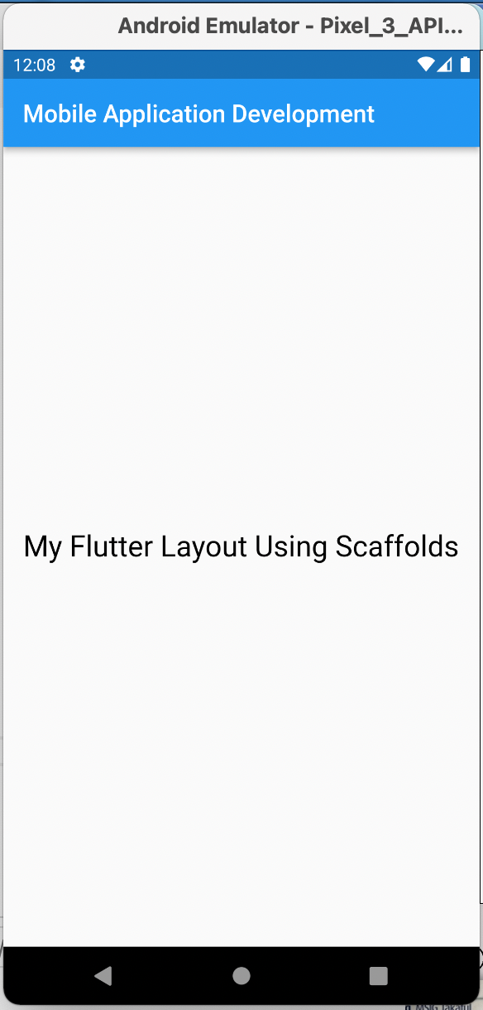
Scaffold properties (2)
2. body
The other essential and necessary properties of the Scaffold widget is body, which will be used to display the Scaffold's major content.
By default, the widgets inside the body are put in the top-left corner of the available area.
The next slide shows an example of the use of the Scaffold body property to center its content using the Center widget.

Slide 18
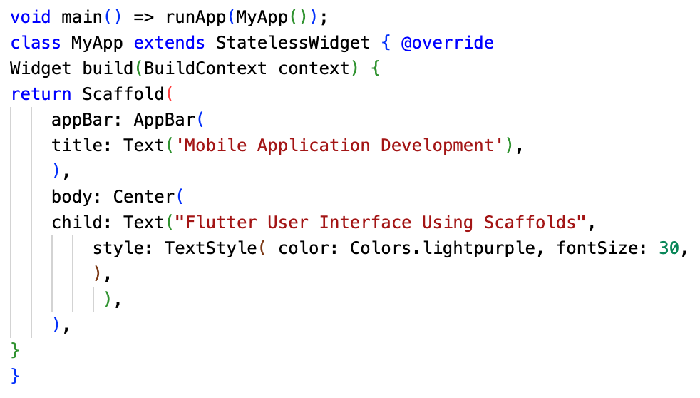
Example codes using appBar

Slide 19
SCAFFOLD PROPERTIES (3)
3. floatingActionButton
A button called floatingActionButton is visible in the bottom right corner and floats above the body.
It is a circle icon button that floats over the screen's content at a specific location to highlight the application's main activity.
The next slide shows an example of the use of the Scaffold floatingActionButton property for creating the button.

Slide 20
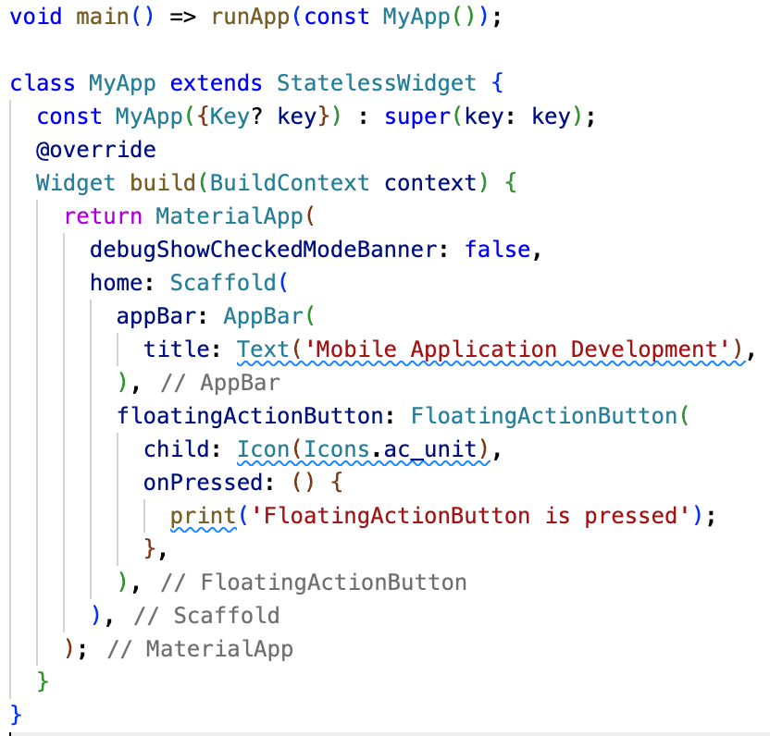
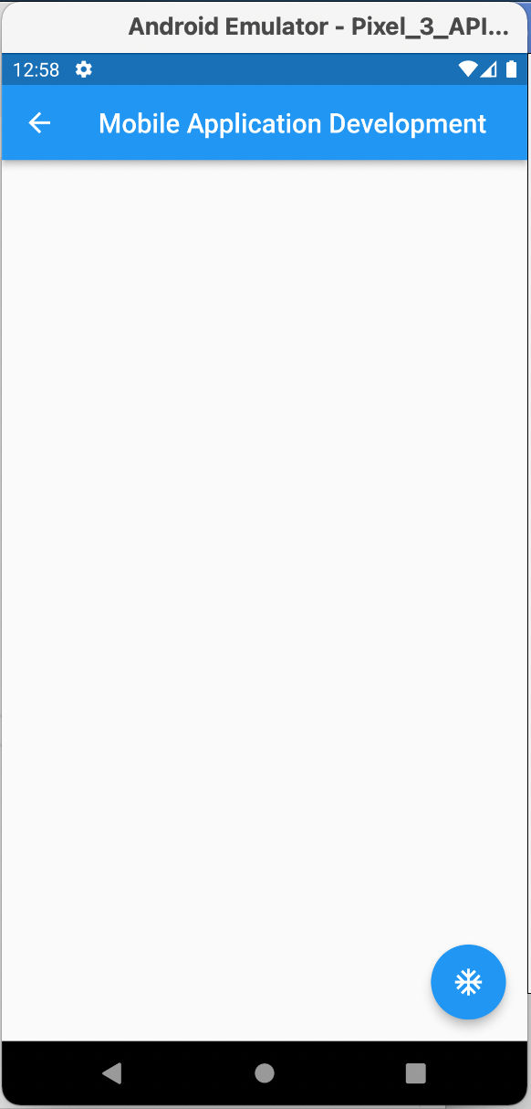
Using floatingActionButton PROPERTY

Slide 21
SCAFFOLD PROPERTIES (4)
4. drawer
A slider panel that is visible at the side of the body is called a drawer.
On mobile devices, it is often concealed, but the user can swipe it from right to left or left to right to reveal the drawer menu.
The next slide shows an example of the use of the Scaffold drawer property for creating a drawer. The example also uses ListView, Header, Menu, and ListTile widgets to make it attractive.

Slide 22
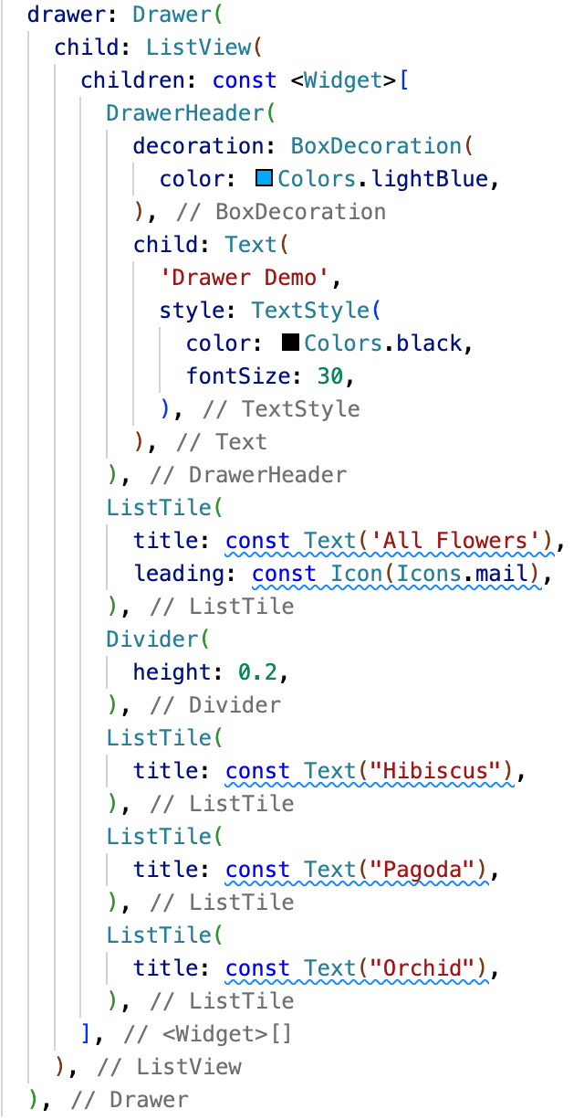
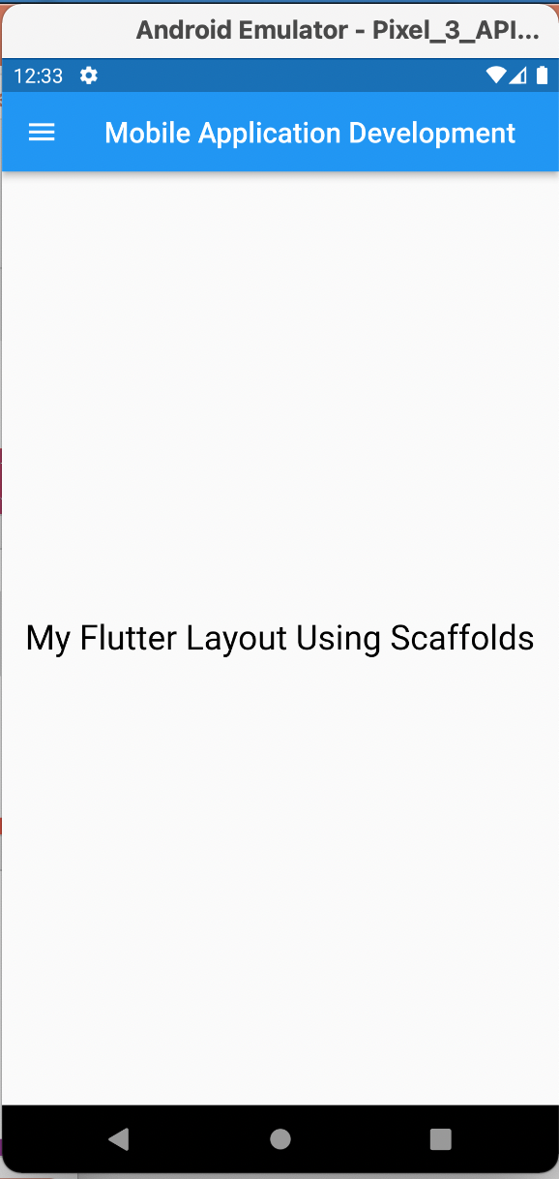
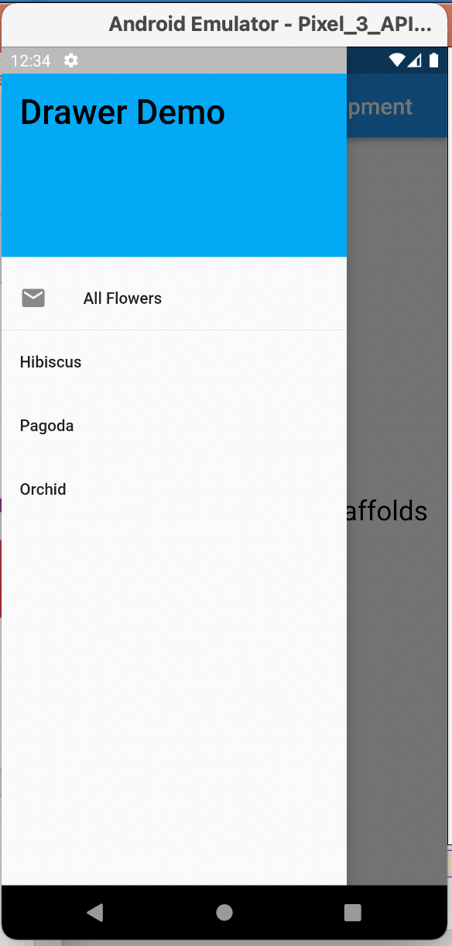
USING drawer PROPERTY

Slide 23
SCAFFOLD PROPERTIES (5)
5. drawer
A navigation bar appears at the bottom of the scaffold when the bottomNavigationBar property is used.
The majority of mobile applications has a bottom navigation bar. Developers can add several icons or texts as elements in the bar using this property.
The next slide shows an example using the Scaffold bottomNavigationBar property for creating a bottom navigation bar.

Slide 24
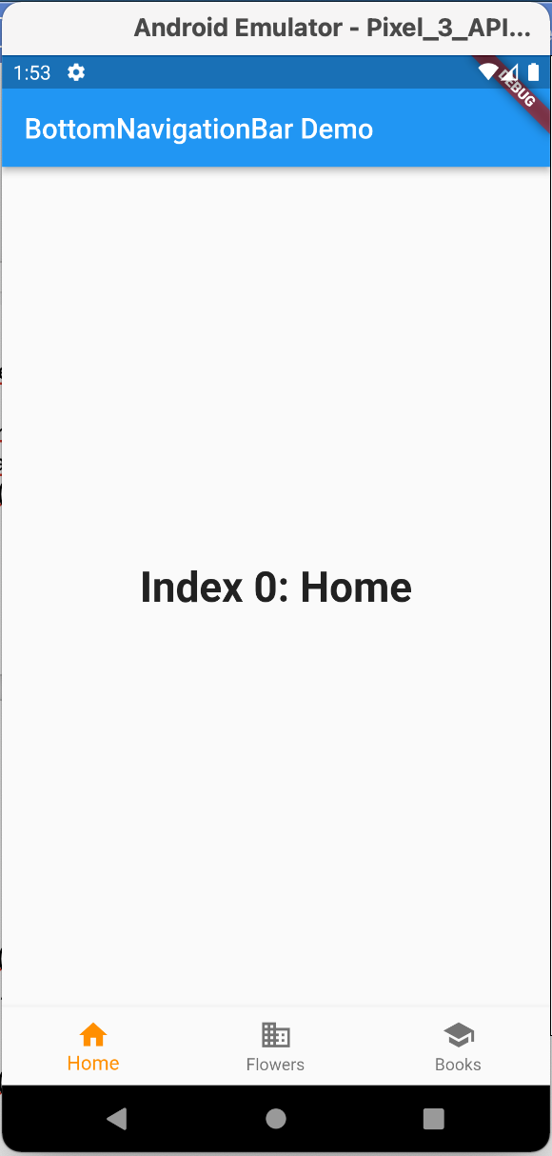
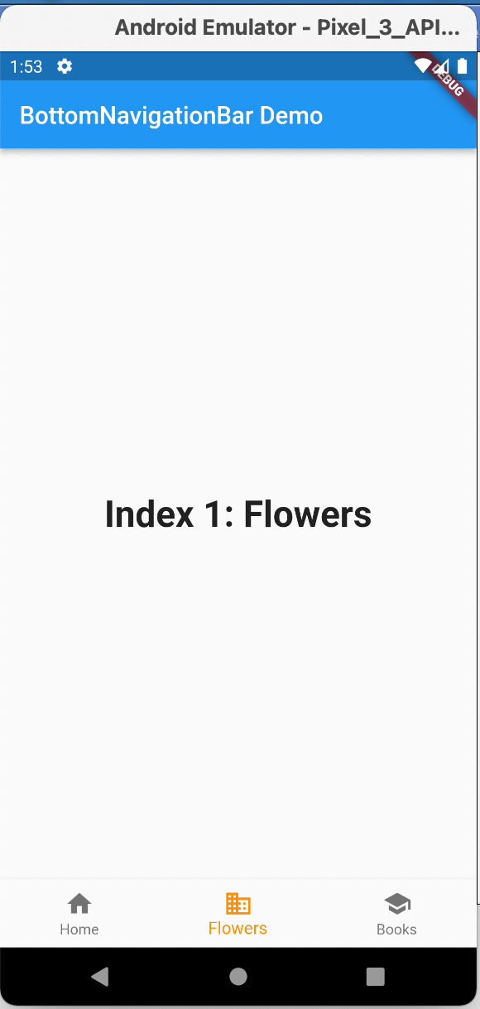
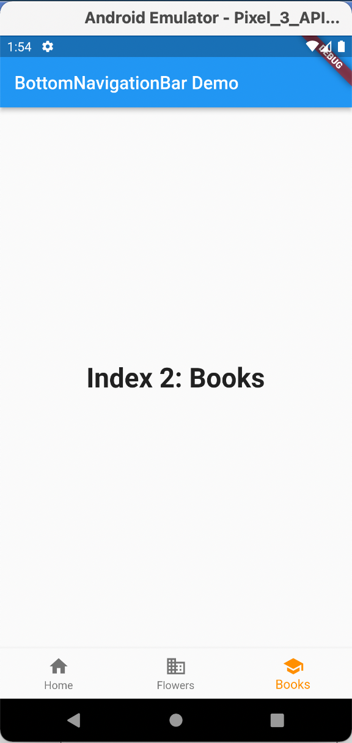
USING bottomNavigationBar

Slide 25
SUMMARY
This lesson describes the definition of Flutter, explain about the Flutter widget, and discusses how to design a mobile app by using Flutter Scaffold widgets. It also shows examples of using 5 important Scaffold properties in designing a simple mobile app.

