Slide 1
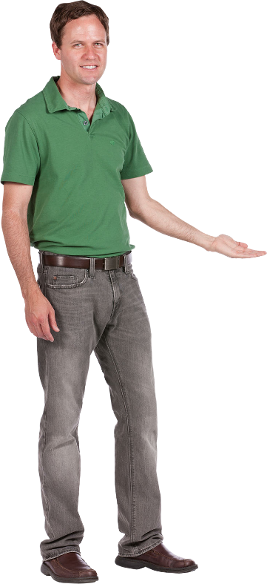
LESSON 9
MEETING (PART 2)
Beginner’s Arabic
(Elementary Level)
Basic Conversation & Vocabulary
Al-‘arabiyyah lil-mubtadi-īn
العربية للمبتدئين

Slide 2
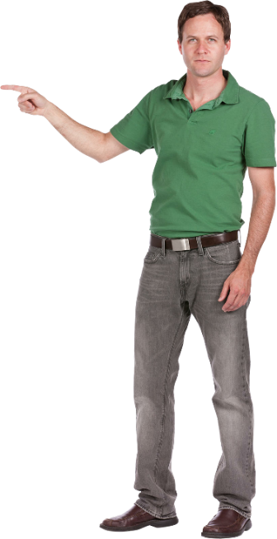

LESSON 9
- MEETING
al-ijtimā’ اَلْاِجْتِمَاعُ
OBJECTIVES
In this chapter, you will learn the following outcomes:
Learn about question words, new words and pronunciation of numbers 91-100.
Read, listen and understand conversation relating to ‘Meeting'.
Communicate with friends through written and practical exercises.

Slide 3
Phrases (al-‘ibārāt اَلْعِبَارَاتُ)
 | PRONUNCIATION | ARABIC PHRASES
Can I come in? | hal yumkin an adkhul? | هَلْ يُمْكِنُ أَنْ أَدْخُلَ؟
Yes, you can come in. | na’am, yumkin an tadkhul | نَعَمْ، يُمْكِنُ أَنْ تَدْخُلَ
Where can I buy the new cloth? | aina yumkin an ashtarī ath-thaub al-jadīd | أَيْنَ يُمْكِنُ أَنْ أَشْتَرِيَ الثَّوْبَ الْجَدِيْدَ؟
You can buy it there. | yumkin an tashtarī hunāka | يُمْكِنُ أَنْ تَشْتَرِيَ هُنَاكَ

Slide 4
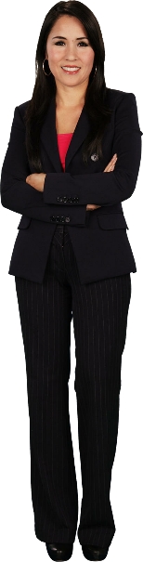
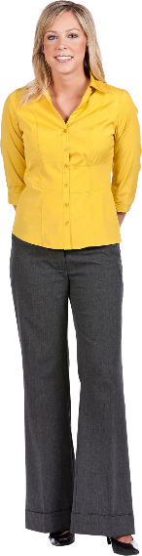
Conversation (al-hiwār الْحِوَارُ)
MEETING
هُوَ يَذْهَبُ إِلَى الْإِدَارَةِ
huwa yadhab ilal-idārah
(2) He go to the office.
أَيْنَ مَالِكُ يَا نَادِرَةُ؟
aina Malik yā Nadirah?
(1) Where is Malik, Nadira?
Nadira
Susan

Slide 5
Conversation (al-hiwār الْحِوَارُ)
MEETING
لاَ، هِيَ فِيْ غُرْفَتِهَا، وَهِيَ تَقْرَأْ مَجَلَّةَ الْكُمْبِيُوْتَر
lā, hiya fil ghurfatihā, wa hiya taqra’ majallah al-kumbiyūtar
(2) No, she in her room and she is reading computer magazine.
هَلْ إِلْسَا فِيْ الْإِدَارَةِ أَيْضًا؟
hal ilsā fil-idārah aidan?
(1) Is Elsa at the office too?
Nadira
Susan

Slide 6
Conversation (al-hiwār الْحِوَارُ)
MEETING
أَنَاَ ذَهَبْتُ إِلَى مَكْتَبُ البَرِيْدِ
ana dhahabtu ilā maktab al-barīd
(2) I went to the post office.
وَأَنْتِ يَا نَادِرَة، إِلَى أَيْنَ ذَهَبْتِ قَبْلَ قَلِيْلٍ؟
wa anti ya Nadirah, ilā aina dhahabti qabla qalīl?
(1) And you Nadira, where did you go just now?
Nadira
Susan

Slide 7
Conversation (al-hiwār الْحِوَارُ)
MEETING
هَيَّا نَذْهَبُ سَوِيًّا
hayya nadhhab sawiyyan
(2) Let’s go together.
عِنْدَنَا الاِجْتِمَاعُ الآنَ
‘indanā al-ijtimā‘ al-ān
(1) We have meeting now.
Nadira
Susan

Slide 8
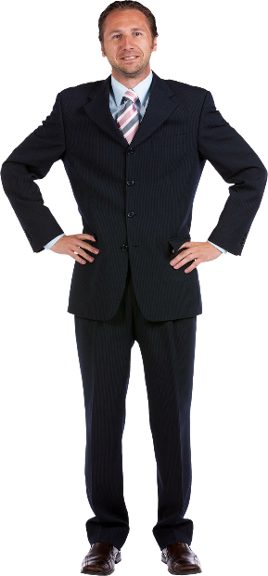
Conversation (al-hiwār الْحِوَارُ)
MEETING
مَسَاءَ النُّوْر
masā an-nūr
(2) Good evening.
مَسَاءَ الْخَيْرِ
masā al-khair
(1) Good evening.
Employees
Meeting chairman

Slide 9
Conversation (al-hiwār الْحِوَارُ)
MEETING
نَحْنُ بِخَيْرٍ
nahnu bikhair
(2) We are fine.
كَيْفَ حَالُكُمْ؟
kaifa hālukum?
(1) How are you?
Employees
Meeting chairman

Slide 10
Conversation (al-hiwār الْحِوَارُ)
MEETING
مَالِك غَائِبٌ، وَإِلْسَا غَائِبَةٌ أَيْضاً
Malik ghāib, wa ilsā ghāibah aidan
(2) Malik is absent and Elsa also absent.
مَنْ غَائِبٌ؟
man ghāib?
(1) Who is absent (not coming)?
Susan
Meeting chairman

Slide 11
Conversation (al-hiwār الْحِوَارُ)
MEETING
هُوَ فِيْ الْإِدَارَةِ وَهِيَ فِيْ غُرْفَتِهَا
huwa fil-idārah wa hiya fī ghurfatihā
(2) He is in the office and she is in her room.
أَيْنَ مَالِك وَأَيْنَ إِلْسَا؟
aina Malik wa aina ilsā?
(1) Where is Malik and where is Elsa?
Meeting chairman
Nadira

Slide 12
Alphabet (al-hurūf اَلْحُرُوْفُ)
ف ق
(ب ت ث) have same shape when you write them but their dots are not the same to differenciate each of them. The letter (ت) also has other shape when located at the end of words which is like this (ـة) or this (ة) and normally this shape is used to indicate feminine words or muannath (مُؤَنَّثٌ).
Find the letter ( ب ) within the words below and write the words nicely.
بَابٌ ثَمَانِيَةٌ صَبَاحًا
sabāhan thamāniyah ism
(pagi) (lapan) (nama)
Find the letter (ت ) within the words below and write the words nicely.
وِلَايَةٌ بُوْمَةٌ حُلْوٌ
hulw būmah wilāyah
(manis) (burung hantu) (wilayah)
Find the letter (ث ) within the words below and write the words nicely.
يَذْهَبُ جَمِيْلَةٌ كِتَابِيْ
kitābī jamīlah yadhhab
(buku saya) (cantik) (dia pergi)

Slide 13
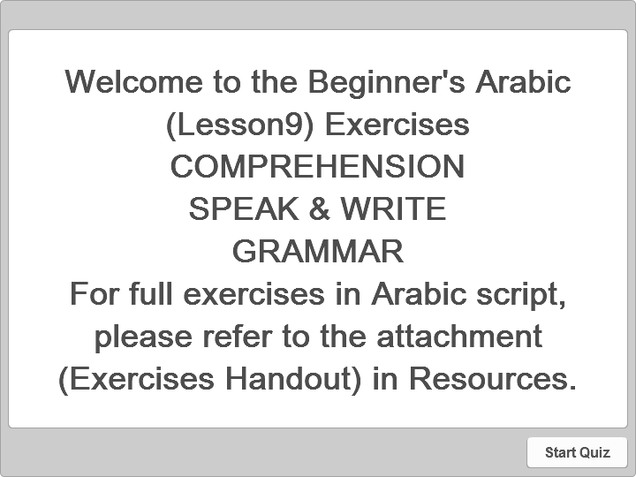


Exercises (at-tadrībāt التَّدْرِيْبَاتُ)
Quiz
COMPREHENSION SPEAK & WRITE GRAMMAR
Click the Quiz button to edit this quiz

Slide 14
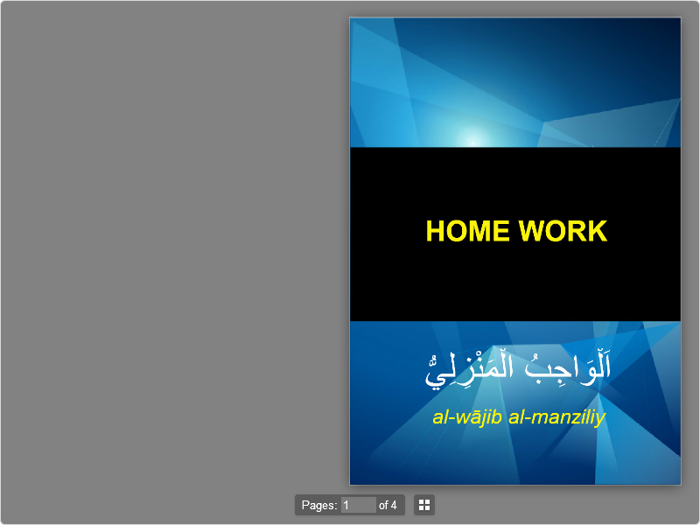

Home Work (al-wājib al-manzili اَلْوَاجِبُ الْمَنْزِلِيُّ )
Book Interaction
Click the Interaction button to edit this interaction

Slide 15

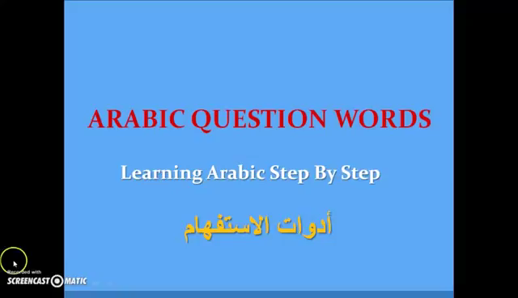
Revision Video (fīdiyū al-murāja‘ah فِيْدِيُو اَلْمُرَاجَعَةُ)
Source: YouTube channel ‘Nour Koudmani’ & MyDubai MyCity‘.

