Slide 1
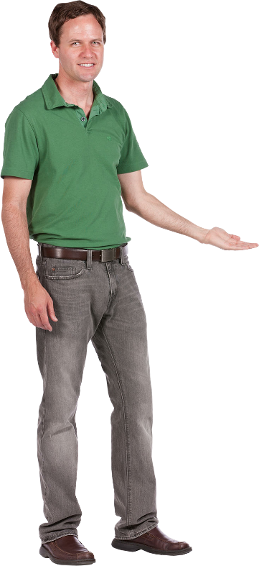
LESSON 9
MEETING (PART 1)
Beginner’s Arabic
(Elementary Level)
Basic Conversation & Vocabulary
Al-‘arabiyyah lil-mubtadi-īn
العربية للمبتدئين

Slide 2
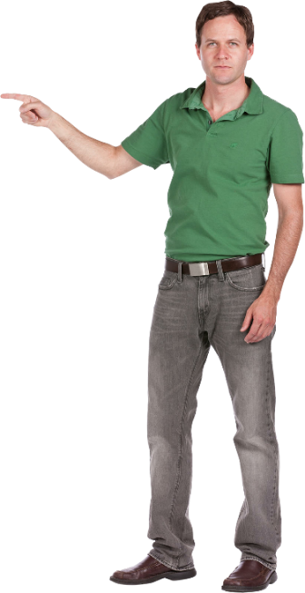

LESSON 9
- MEETING
al-ijtimā’ اَلْاِجْتِمَاعُ
OBJECTIVES
In this chapter, you will learn the following outcomes:
Learn about question words, new words and pronunciation of numbers 91-100.
Read, listen and understand conversation relating to ‘Meeting'.
Communicate with friends through written and practical exercises.

Slide 3
Vocabulary (al-mufradāt الْمُفْرَدَاتُ)
إِدَارَةٌ
idārah (idāroh)
Office
مُنَى فِيْ الإِدَارَةِ
Muna fil-idarah
Muna in the office.
* With phonetic sign at the end, we pronounce it: i-da-ra-tun

Slide 4
Vocabulary (al-mufradāt الْمُفْرَدَاتُ)
حُجْرَة المُؤنِ
hujrah al-muan
Pantry
هُوَ فِيْ حُجْرَة المُؤنِ
Huwa fi hujratil-muan
He is in the pantry.
* With phonetic sign at the end, we pronounce it: huj-ra-tul-mu-an

Slide 5
Vocabulary (al-mufradāt الْمُفْرَدَاتُ)
سِكْرَتِيْرٌ
sikratīr
Secretary
هُوَ سِكْرَتِيْر
Huwa sikratīr
He is a secretary.
* With phonetic sign at the end, we pronounce it: sik-ra-tī-run

Slide 6
Vocabulary (al-mufradāt الْمُفْرَدَاتُ)
بِطَاقَةُ العَامِلِ
bitāqah al-‘āmil
Employee Card
هَذِهِ بِطَاقَةُ العَامِلِ
hādhihi bitāqah al-’āmil
This is employee card.
* With phonetic sign at the end, we pronounce it: bi-tā-qa-tul-‘ā-mil

Slide 7
Vocabulary (al-mufradāt الْمُفْرَدَاتُ)
مُخْتَبَرٌ
mukhtabar
Laboratory
مُخْتَبَرُ الْكُمْبِيُوْتَرِ مُغْلَقٌ
mukhtabar al-kumbiyutar mughlaq
The computer laboratory is closed.
* With phonetic sign at the end, we pronounce it: mukh-ta-ba-run

Slide 8
Vocabulary (al-mufradāt الْمُفْرَدَاتُ)
دَفْتَرٌ
daftar
Note book
The new note book is under the chair.
الدَّفْتَرُ الْجَدِيْدُ تَحْتَ الْكُرْسِيِّ
Ad-daftar al-jadīd tahta al-kursiy
* With phonetic sign at the end, we pronounce it: daf-ta-run

Slide 9
Vocabulary (al-mufradāt الْمُفْرَدَاتُ)
مِسْطَرَةٌ
mistarah (mistoroh)
Ruler
I want a ruler.
أنَا أُرِيْدُ مِسْطَرَةً
ana urīd mistarah
* With phonetic sign at the end, we pronounce it: mis-ta-ra-tun

Slide 10
Vocabulary (al-mufradāt الْمُفْرَدَاتُ)
قَاعَةٌ
qā‘ah (qō‘ah)
Hall
هَذِهِ قَاعَةٌ جَدِيْدَةٌ
hādhihi qā‘ah jadīdah
This is a new hall.
* With phonetic sign at the end, we pronounce it: qā-‘a-tun

Slide 11
Vocabulary (al-mufradāt الْمُفْرَدَاتُ)
مَوْقِفُ السَّيَّارَاتِ
mauqif as-sayyārāt
Car park
The car park is there.
مَوْقِفُ السَّيَّارَاتِ هُنَاكَ
mauqif as-sayyārāt hunaka
* With phonetic sign at the end, we pronounce it: mau-qi-fus-say-yā-rā-ti

Slide 12
Vocabulary (al-mufradāt الْمُفْرَدَاتُ)
مَوْعِدٌ
mau‘id
Appointment/date
عِنْدِيْ مَوْعِدٌ اَلْيَوْمَ
‘indi mau’id al-yaum
I have an appointment today.
* With phonetic sign at the end, we pronounce it: mau-‘i-dun

Slide 13
Number (ar-raqm الرَّقْمُ)
92
93
اِثْنَانِ وَتِسْعُوْنَ
91
ثَلاَثَةٌ وَتِسْعُوْنَ
ithnān wa tis‘ūn
وَاحِدٌ وَتِسْعُوْنَ
thalāthah wa tis‘ūn
wāhid wa tis‘ūn
94
95
أربَعَةٌ وَتِسْعُوْنَ
خَمْسَةٌ وَتِسْعُوْنَ
arba‘ah wa tis‘ūn
khamsah wa tis‘ūn

Slide 14
Number (ar-raqm الرَّقْمُ)
97
98
سَبْعَةٌ وَتِسْعُوْنَ
96
ثَمَانِيَةٌ وَتِسْعُوْنَ
sab‘ah wa tis‘ūn
سِتَّةٌ وَتِسْعُوْنَ
thamāniyah wa tis‘ūn
sittah wa tis‘ūn
99
100
تِسْعَةٌ وَتِسْعُوْنَ
اَرْبَعُوْنَ
tis‘ah wa tis‘ūn
mi’ah

Slide 15
Grammar (an-nahwu النَّحْوُ )
QUESTION WORDS
WORD | PRONUNCIATION | TRANSLATION
مَا | mā | What?
مَاذَا | mādhā | What do you? /What are you?
لِمَاذَا | limādhā | Why?
أَيْنَ | aina | Where?
إِلَى أَيْنَ | ilā aina | To where?
كَيْفَ | kaifa | How?
مَتَى | matā | When?
هَلْ | hal | Is it? / Do you? / Are you?
مَنْ | man | Who?
لِمَنْ | liman | Whose? / For who?
كَمْ | kam | How many? / How much?

