Slide 1
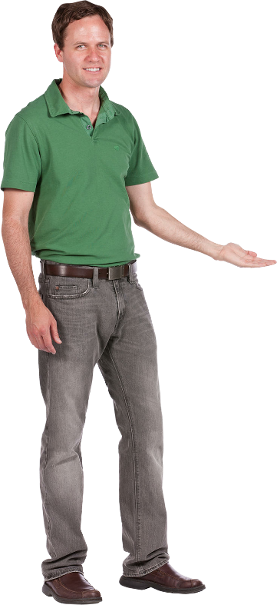
Beginner’s Arabic
(Elementary Level)
LESSON 8
SEMESTER BREAK (PART 1)
Basic Conversation & Vocabulary
Al-‘arabiyyah lil-mubtadi-īn
العربية للمبتدئين

Slide 2
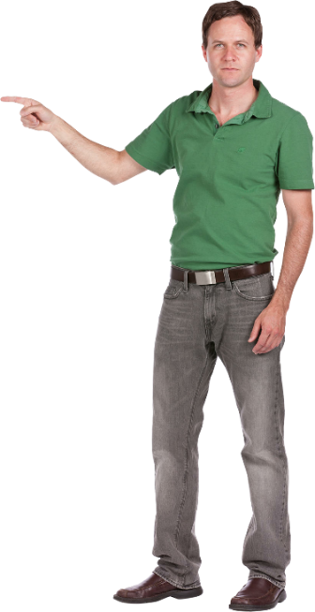

LESSON 8
- SEMESTER BREAK
al-‘utlah al-fasliyyah الْعُطْلَةُ الْفَصْلِيَّةُ
OBJECTIVES
In this chapter, you will learn the following outcomes:
Learn about constructing sentences, new words and pronunciation of numbers 81-90.
Read, listen and understand conversation relating to ‘Semester Break'.
Communicate with friends through written and practical exercises.

Slide 3
Vocabulary (al-mufradāt الْمُفْرَدَاتُ)
شَلاَّلٌ
shallāl
Water fall
I go to water fall.
أَنَا أَذْهَبُ إِلَى الشَّلاَّلِ
ana adhhab ilā ash-shallāl
* With phonetic sign at the end, we pronounce it: shal-lā-lun

Slide 4
Vocabulary (al-mufradāt الْمُفْرَدَاتُ)
جَبَلٌ
jabal
Hill / Mountain
The hill is very big.
الْجَبَلُ كَبِيْرٌ جِدًّا
al-jabal kabīr jiddan
* With phonetic sign at the end, we pronounce it: ja-ba-lun

Slide 5
Vocabulary (al-mufradāt الْمُفْرَدَاتُ)
اَلْحَدِيْقَةُ الْوَطَنِيَّة
al-hadīqah al-wataniyyah
National Park
I went to national park yesterday.
ذَهَبْتُ إِلَى اَلْحَدِيْقَةُ الْوَطَنِيَّةِ أَمْسِ
Dhahabtu ilā al-hadīqah al-wataniyyah amsi
* With phonetic sign at the end, we pronounce it: al-ha-dī-qa-tu al-wa-ta-niy-ya-tu

Slide 6
Vocabulary (al-mufradāt الْمُفْرَدَاتُ)
شَاطِئٌ
shāti’
Beach
اَلشَّاطِئُ جمِيْلٌ جِدًّا
ash-shāti’ jamīl jiddan
The beach is very beautiful.
* With phonetic sign at the end, we pronounce it: shā-ti-un

Slide 7
Vocabulary (al-mufradāt الْمُفْرَدَاتُ)
نَهْرٌ
nahr
River
اَلنَّهْرُ َطَوِيْلٌ
an-nahr tawīl
The river is long.
* With phonetic sign at the end, we pronounce it: nah-run

Slide 8
Vocabulary (al-mufradāt الْمُفْرَدَاتُ)
قِطَارٌ
qitār (qitōr)
Train
اَلْقِطَارُ جَدِيْدٌ
al-qitar jadīd
The train is new.
* With phonetic sign at the end, we pronounce it: qi-tā-run

Slide 9
Vocabulary (al-mufradāt الْمُفْرَدَاتُ)
طَائِرَةٌ
tāirah (tōiroh)
Aeroplane
The aeroplane is small.
اَلطَّائِرَةُ صَغِيْرَةٌ
At-tāirah saghīrah
* With phonetic sign at the end, we pronounce it: tā-i-ra-tun

Slide 10
Vocabulary (al-mufradāt الْمُفْرَدَاتُ)
جَمِيْلٌ
jamīl
Beautiful
The pen is beautiful.
اَلْقَلَمُ جَمِيْلٌ
al-qalam jamīl
* With phonetic sign at the end, we pronounce it: ja-mī-lun

Slide 11
Vocabulary (al-mufradāt الْمُفْرَدَاتُ)
أَصْعَدُ
as‘ad
I climb
أَصْعَد الْجَبَلَ اَليَوْمَ
as’ad al-jabal al-yaum
I climb the mountain today.
* With phonetic sign at the end, we pronounce it: as-‘a-du

Slide 12
Vocabulary (al-mufradāt الْمُفْرَدَاتُ)
أَسْبَحُ
asbah
I swim
أَسْبَحُ فِيْ النَّهْرِ
asbah fi an-nahr
I swim in the river.
* With phonetic sign at the end, we pronounce it: as-ba-hu

Slide 13
Number (ar-raqm الرَّقْمُ)
82
83
اِثْنَانِ وَثَمَانُوْنَ
81
ثَلاَثَةٌ وَثَمَانُوْنَ
ithnān wa thamānūn
وَاحِدٌ وَثَمَانُوْنَ
thalāthah wa thamānūn
wāhid wa thamānūn
84
85
أربَعَةٌ وَثَمَانُوْنَ
خَمْسَةٌ وَثَمَانُوْنَ
arba‘ah wa thamānūn
khamsah wa thamānūn

Slide 14
Number (ar-raqm الرَّقْمُ)
87
88
سَبْعَةٌ وَثَمَانُوْنَ
86
ثَمَانِيَةٌ وَثَمَانُوْنَ
sab‘ah wa thamānūn
سِتَّةٌ وَثَمَانُوْنَ
thamāniyah wa thamānūn
sittah wa thamānūn
89
90
تِسْعَةٌ وَثَمَانُوْنَ
تِسْعُوْنَ
tis‘ah wa thamānūn
tis‘ūn

Slide 15
Grammar (an-nahwu النَّحْوُ )
BUILDING SENTENCES
NOMINAL SENTENCES | 1 | Noun + noun
 |  | al-qalam jadīd |  | القَلَمُ جَدِيْدٌ
 |  | The pen is new.
 | 2 | Noun + verb
 |  | at-tālib yanām |  | الطَّالِبُ يَنَامُ
 |  | The student is sleeping.
 | 3 | Noun + preposition/conjunction + noun
 |  | ummī fī al-bait | أُمِّيْ فِيْ البَيْتِ
 |  | My mother is in the house (or at home).

Slide 16
Grammar (an-nahwu النَّحْوُ )
BUILDING SENTENCES
VERBAL SENTENCES | 1 | Verb + noun
 |  | yanam at-tālib |  | يَنَامُ الطَّالِبُ
 |  | The student is sleeping.
 | 2 | Verb + noun + noun
 |  | yashrab abī ash-shāi | يَشْرَبُ أَبِيْ الشَّايَ
 |  | My father is drinking tea.
 | 3 | Verb + preposition/conjunction + noun
 |  | darasnā fi al-ma‘mal | دَرَسْنَا فِيْ المَعْمَلِ
 |  | We learned at the laboratory.

